Slide 1


Slide 2
Presented By:
Abhishek Mishra
submission Date:21/01/2023

Slide 3
Housing : Pricing Prediction Project
Objective, problem statement, EDA process and model dashboard.

Slide 4
What is House Price Prediction?
Company uses ‘Data Analytics’ to purchase houses at a price below their actual value and flip them at a higher price.
Predictive Modeling are some ML techniques used for achieving the business goals for housing companies.
Required to model the price of houses with the available independent variables.
Model then be used to understand how exactly the prices vary with the variables.

Slide 5
Problem Statement
Need of Housing and Real Estate in the world
The role of Data Science in the Real Estate business across glob.
It helps companies to increase their overall revenue, profit, improving marketing strategies.
Predictive Modelling always help for achieving the business goals for housing companies.
In the related prediction there is company ‘Surprise Housing’ has decided to enter the Australian Market.
The company uses Data Analytics to purchase houses at a price below their actual values and flip them at a higher price.

Slide 6
Requirements of the company
The company collected some data from the sale of house in Australia.
Required to build a model by using Machine Learning in order to predict the actual value of the prospective properties and decide whether to invest or not.
Company wants to know which Variable is important to predict the price of variable.

Slide 7
Analysis of Dataset & Problem Statement:-
Our target column is ‘SalePrice’ because we are going to predict the price
Target column is Continuous so we can say that the problem is related to the regression problem
Datatype of our target variable is ‘Float’ so this problem will be related to ‘Linear Regression’.
Data set has been spllited into two parts test and train so need to combine the dataset for analysis

Slide 8
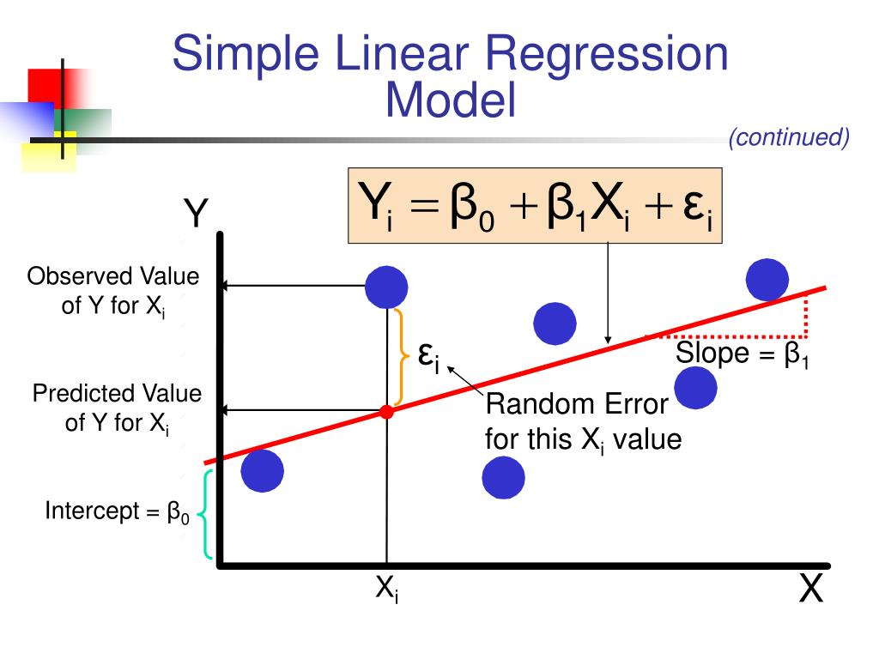
Linear Regression:-
Linear Regression is a machine learning algorithm based on supervised learning. It performs a regression task. Regression models a target prediction value based on independent variables.

Slide 9
EDA Process:-
Explore the data analysis by the help of some functions and library to find out whether the data is perfect or not
Finding for the ‘Missing Values’
Treatment of the missing value by using some statistics(mean value)
Checking for the skewness in the data and found some variable has some skewness
Treated the skewness by using Log transformer and BOXCOX method.
Found the Outliers by using the Data Visualization.
Used the boxplot to see the outliers in the data

Slide 10
EDA
Importing the ‘SciPy’ library and used the zscore method for treatment of the outliers in the data.
We are going to use the different types of plots for Univariate analysis and bivariate analysis to find out the relation between variables and target.
Completed all the Data preprocessing and feature engineering
Drop the some variables as it is not required for the price prediction.
Finding the Correlation between each variables with target to avoid the Multicollinearity.
Finding the new shape after all the EDA steps to find out the dataloss during EDA.

Slide 11
Splitting Dataset:-
Split the dataset into two parts that is independent variable and dependent variable(Target column),
We can also say that this split is nothing but the data for training and testing.
We provide the 70% data for training and rest 30% data will be for testing.
Call the train-test function for the further process.

Slide 12
Model Building:-
Now call the Linear Regression model.
Fit the training part into linear regression (lm.fit(x_train,y_train)
Finding the coefficient and intercept value for the model
Lm.coef_
Lm.intercept_
Finding the score for the training data of model
Lm.score(x_train,y_train)

Slide 13
Model Testing:-
Here we are going for the prediction of the model.
Pred=lm.predict(x_test)
Finding the result price as prediction of the model
Finding the actual price by performing the y_test function.

Slide 14
Evaluation Metrics:-
Evaluation metrics for a linear regression model Evaluation metrics are a measure of how good a model performs and how well it approximates the relationship.
Root mean squared error,Mean absolute error and R2 score these are the metrics through which we need test the model
R2 score shows that how much our output changes when input is being changed. It is also known as Coefficient of Determination.

Slide 15
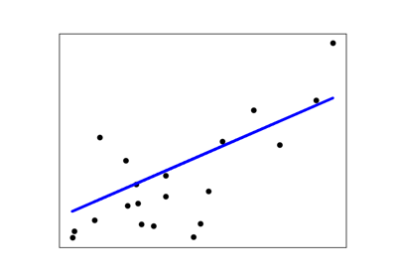
R2 score visualizations:-

Slide 16
Conclusion:-
Compairing the actual price and predicted price by the Model
We can give some values (inputs) in the form of array and can verify the accuracy of the prediction
But the data should be two dimensional as we had train the machine for the two dimensional data.
Saving the model and submission of the Model
Using the pickle to save the model.
To save model in CSV file we use the dataframe to csv function and save the model.

Slide 17
Thank You

